Slide 1
Meeting Report
Lily Leung 20170803

Slide 2
Lambert Beer’s Law
ln (I_{o}/I’)= nσl In NSRRC: I_{o}=I₁+I₂
I’=I₁’+I₂’, where I₂=I₂’
Hence, Detector detected:
ln(Io/I’)=n_{d} σl
Real: ln(I₁/I₁’)=n_{R} σl
I₂
I₁

Slide 3
Lambert Beer’s Law
Use aperture to block the extra IR light
Assume the intensity of the VUV beam is uniform
I₂
I₂
I₁
I₁’

Slide 4
Advised Beer’s Law - Production
I_{o}=I₁º+I₂º since I₁o=0.21/0.14 I₂º & I₁º=1.5I₂º
I’=I₁’+I₂’ since I₂º=I₂’ I’= I₁’+I₂º
Hence, I_{o}= 5/3 I₁º and I’=I₁’ + 2.5I_{o}
I₂
I₂
I₁
I₁’

Slide 5
Advised Beer’s Law- Production
Hence, I_{o}= 5/3 I₁º and I’=I₁’ + 2.5I_{o}
I₁º/I₁’=(3/5 Io )/ (I’-2/5I_{o})
Hence, we may use this to calculate upper limit.
I₂
I₂
I₁
I₁’

Slide 6

Advised Beer’s Law- Production
$I′=I_{1}^{′}+I_{2}^{′}=I_{1}^{′}+I_{2}^{o}$=$\frac{I_{1}^{o}}{e^{yA}}+I_{2}^{o}$
$\frac{0.6 I^{o}}{e^{yA}}+0.4I^{o}$
$\frac{I^{"}}{I^{o}}=\frac{0.6}{e^{yA}}+0.4$
CN-:25ML | production | =exp(-2.5e16*1.8e-17) | 0.637628152
 |  | answer-0.4 | 0.237628152
 |  | =0.6/answer | 2.524953361
 |  | ln(answer) | 0.926222591
 |  | =answer/1.8e-17 | 5.14568E+16
 |  | ratio= | 2.058272426

Slide 7
Advised Beer’s Law- Consumption
By getting R ln(I₁/I₁”) + (1-R)ln(I₂/I₂’) can get the real column Density of Reactant
R= 0.21/0.35 =0.6
The I₁/I₁” is (3/5 I )/ (I”-2/5 I’) from the previous deviation
Where I₂/I₂’ = (I/2.5)/(I’/2.5) = (I/I’)
Hence, Real Column Density = 0.6 * ln[(3/5 I )/ (I”-2/5 I’) ] +0.4*ln (I/I’)
I₂
I₂’
I₂’
I₁
I₁’
I₁”
I = I₁+I₂
I’ = I₁’+I₂’
I” = I₁”+I₂”

Slide 8






Since $I^{′}=I^{o}e^{-nσl}$
$I"=I_{1}^{"}+I_{2}^{"}=I_{1}^{"}+I_{2}^{′}$=$\frac{I_{1}^{o}}{e^{xσl}}+\frac{I_{2}^{o}}{e^{sσl}}=\frac{0.6 I^{o}}{e^{xσl}}+\frac{0.4I^{o}}{e^{sσl}}$
$$\frac{I^{"}}{I^{o}}=\frac{0.6}{e^{xσl}}+\frac{0.4}{e^{sσl}}$$
ML of what we deposited
What we measure
What we want
I₂
$s$ ML
I₂’
$s$ ML
I₂’
I₁
I₁’
$s$ ML
I₁”
$x$ ML
I = I₁+I₂
I’ = I₁’+I₂’
I” = I₁”+I₂”

Slide 9

$$\frac{I^{"}}{I^{o}}=\frac{0.6}{e^{xσl}}+\frac{0.4}{e^{sσl}}$$
NH₃ in last irradiation 488 ML | total 600ML | A value 1.7e-17 cm molecule -1
L.H.S= e^-(4.88e17*1.7e-17) | 0.000249513
R.H.S. = 0.4/e^(6e17*1.7e-17)+0.6/e^(x*1.7e-17) | 1.48681E-05
= L.H.S - first term of R.H.S | 0.000234645
=0.6/answer | 2557.056914
=ln (answer/1.7e-17) | 4.61565E+17
ratio | 0.94583079

Slide 10
MDHL flux varies
Dose for 270min
RATIO | date | CH4+NH3 | AVERAGE | stdev | dev/average%
3:2 | 0405 | 8.58E+17 | 8.62E+17 | 1.56546E+16 | 1.82%
 | 0406 | 8.55E+17
 | 0410 | 8.42E+17
 | 0412 | 8.60E+17
 | 0414 | 8.71E+17
 | 0417 | 8.88E+17
1:5 | 0421 | 9.45E+17 | 9.48E+17 | 3.2532E+15 | 0.34%
 | 0424 | 9.48E+17
 | 0426 | 9.52E+17
1:10 | 0427 | 9.56E+17 | 9.57E+17 | 1.87705E+15 | 0.20%
 | 0428 | 9.56E+17
 | 0429 | 9.59E+17
1:20 | 0502 | 9.53E+17 | 9.53E+17 | 2.21133E+15 | 0.23%
 | 0503 | 9.52E+17
 | 0505 | 9.56E+17
450MIN | 0508 | 1.58E+18
 | 0510 | 1.57E+18
 |  | overall: | 9.17E+17 | 4.69536E+16 | 5.12%
RATIO | date | CH4+NH3+H2O | AVERAGE | stdev | dev/average%
1:5:5 | 0512 | 8.12E+17 | 8.20E+17 | 1.15258E+16 | 1.41%
 | 0515 | 8.28E+17
1:10:10 | 0518 | 8.23E+17 | 8.25E+17 | 3.11127E+15 | 0.38%
 | 0519 | 8.27E+17
5:3:4 | 0522 | 7.78E+17 | 7.85E+17 | 1.54124E+16 | 1.96%
 | 0524 | 7.75E+17
 | 0527 | 8.03E+17
 |  | overall: | 8.07E+17 | 2.23746E+16 | 2.77%
Difference between water added and without water
CH4+NH3 | CH4+NH3+H2O | ratio | %
9.17E+17 | 8.07E+17 | 1.14E+00 | 14.00%

Slide 11
NSRRC flux deviation
CH4+NH3+H2O | Date: | Au-mesh | Ni-Mesh dose | dev in Au | dev in Ni
 | 0713 | 2.07E-04 | 2.32E-04 | 0.55% | 2.71%
 | 0714 | 2.05E-04 | 2.25E-04
 | 0715 | 2.04E-04 | 2.20E-04
CH4+NH3 | 0707 | 2.04E-04 | 2.24E-04 | Ni-mesh value calculated by average of 0713 to 0715 factor
 | 0708 | 2.05E-04 | 2.25E-04
 | 0711 | 2.04E-04 | 2.69E-04 | 0.27% | 8.81%
 | 0712 | 2.04E-04 | 2.43E-04

Slide 15
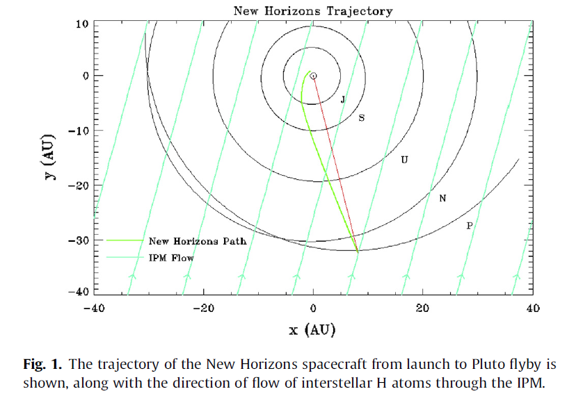
Report on Ly α @Pluto
Consist of 2 extinction:
Direct radiation from the sun (power: 70% onto pluto)
Emission of Ly α by IPM atomic hydrogen (power: 30% onto pluto)
Both are resonant scattered from part with light to the part without light by the hydrogen from pluto’s atmosphere
Gladstone et al. Icarus 246, 279 (2015)

Slide 16
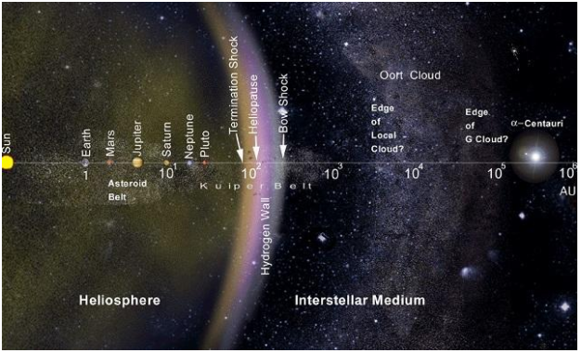
Comparable power : Direct radiation from sun reduce by 1/r² where IPM emission is throughout the solar system
39 A. U.
https://kknews.cc/science/en2lelr.html

Slide 17
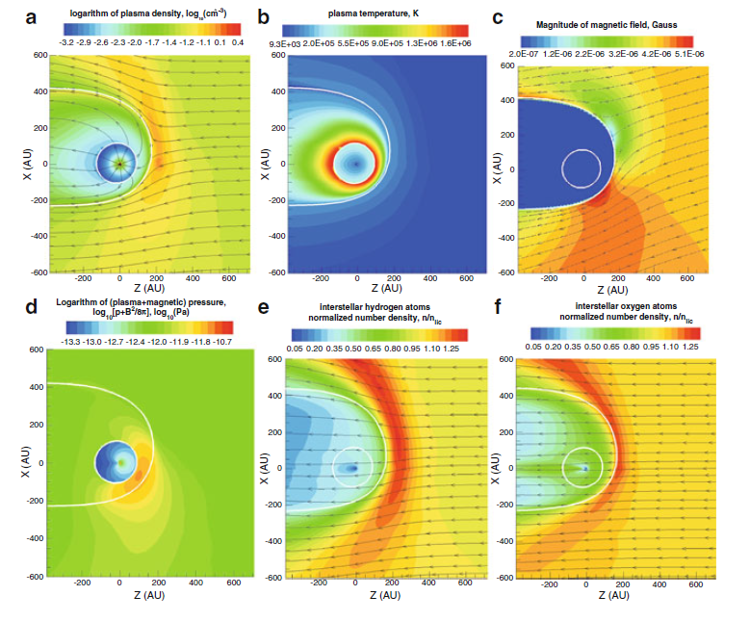
Solar wind plasma
having equal dynamic pressures (thermal & magnetic) forming termination shock
Exchange charge with neutral H He forming magnetic field
Magnetic field changes the flow direction of the hydrogen atoms but not oxygen atoms
Gladstone G.R., Stern S.A., Pryor W.R. (2013) New Horizons Cruise Observations of Lyman-α Emissions from the Interplanetary Medium. In: Quémerais E., Snow M., Bonnet RM. (eds) Cross-Calibration of Far UV Spectra of Solar System Objects and the Heliosphere. ISSI Scientific Report Series, vol 13. Springer, New York, NY

Slide 18
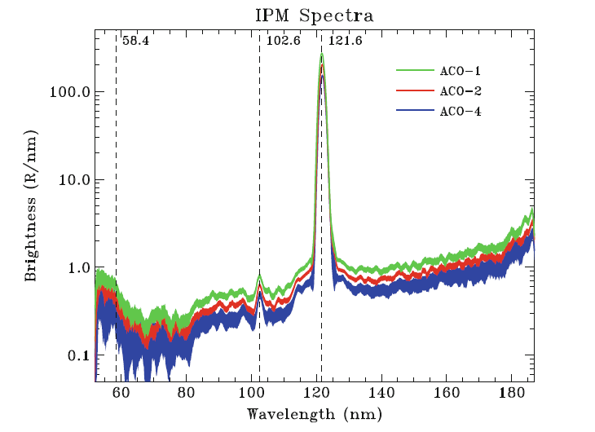
Corrected Emission from IPM
3 data obtaining night spectra by Alice camera.
At 7.6, 11.3, 17.0 AU
He I emission
Gladstone G.R., Stern S.A., Pryor W.R. (2013) New Horizons Cruise Observations of Lyman-α Emissions from the Interplanetary Medium. In: Quémerais E., Snow M., Bonnet RM. (eds) Cross-Calibration of Far UV Spectra of Solar System Objects and the Heliosphere. ISSI Scientific Report Series, vol 13. Springer, New York, NY

Slide 19
Conclusion
We have successfully set up an equation for the conversion of consumption of NSRRC reactants
The Ly α on Pluto is 70% from solar occulation in power and 30% from IPM emission
The factor of He I and He II should also be found.

Slide 21
Paper:
Rarefied gas dynamic simulation of transfer and escape in the Pluto-charon system
William A. Hoey, Seng Keat Yeoh, Laurence M. Trafton, David B. Goldstein, Philip L. Varghese
Icarus 287, (2017) 87-102

Slide 22
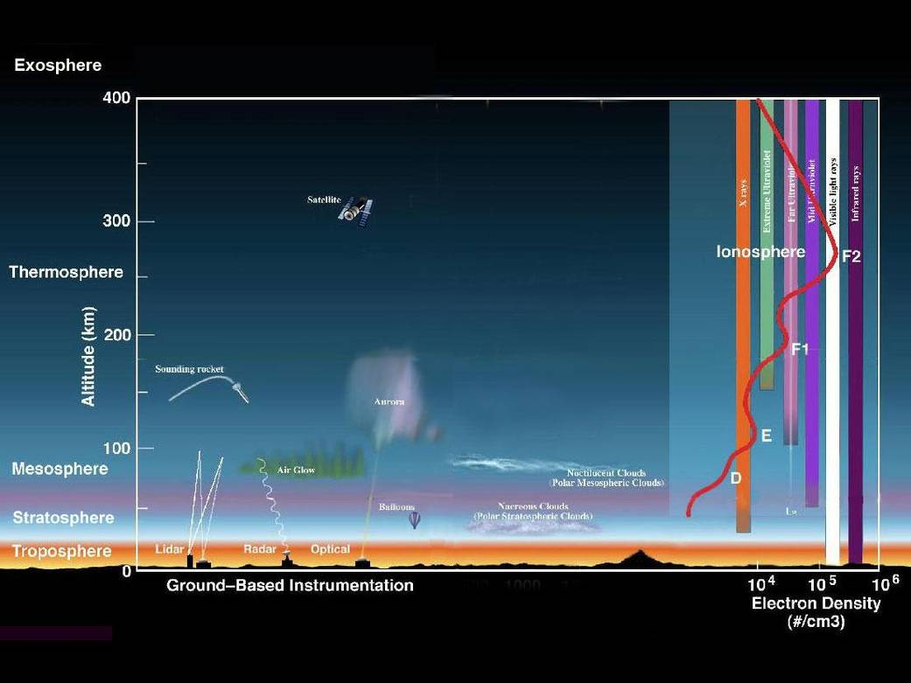
Paper Report: The CH₄ arrival on Charon by Pluto
Situation on Pluto
Earth Atm: Courtesy from NASA
Consider Above Exobase
T= 70 K cooling by HCN & C₂H₂
Exosphere: 42% of CH₄ dominates
1800 km from ground
N₂ dominated
Ice: N₂ dominated

Slide 23
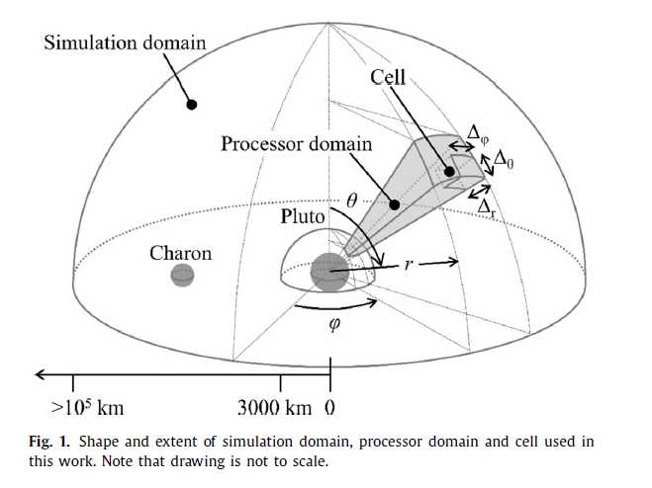
Modeling:
Different from Traditional hydrodynamic escape modelling, they use molecule by molecule Jeans process which is proven to be true.
Considered effects of Pluto’s rotation (gravitation field, centrifugal force & carioles force)
Gravitational field of Charon which perturbs Pluto’s exobase
Considered collisions altering flow field.
The model has employ a two-species model including methane
Investigated deposition of gas onto Charon

Slide 24
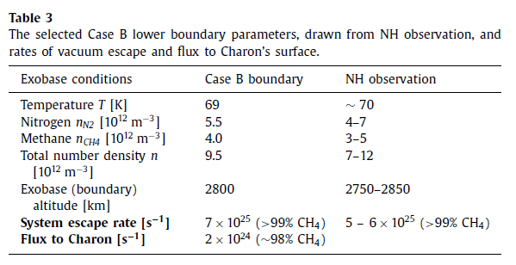
Assumption: Charon sink: All particles impact with charon stick onto charon
About 1.57 times larger than last week:
flux to charon:2x10²⁴ s⁻¹ =4.25 x10¹¹ m⁻² s⁻¹

Slide 25
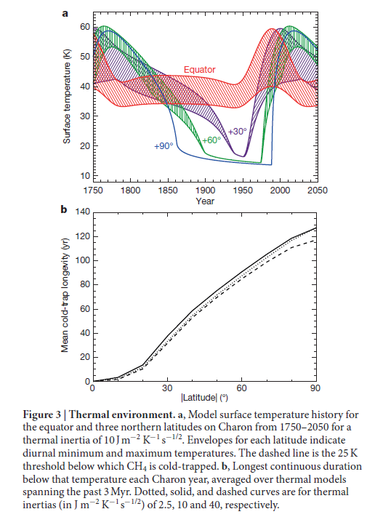
Recall last week:
130 years (2.7 x 10¹¹ molecules m⁻² s⁻¹)
Accumulated only 45º
If constant rate
110 ML deposited on pole
55 ML on 45º

Slide 26
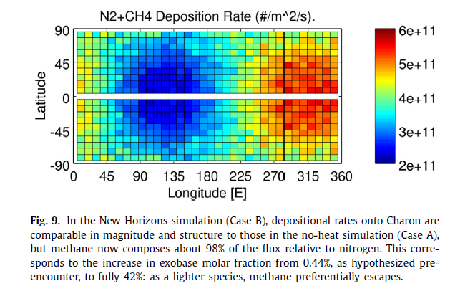
Hitting rates (assuming molecules do not move)
Facing Pluto

Slide 27
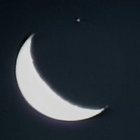
Surface pressure limit
1. by VUV absorption during occultation
From cross-sections & hydrostatic & isothermal models
2. by airglow

Slide 28
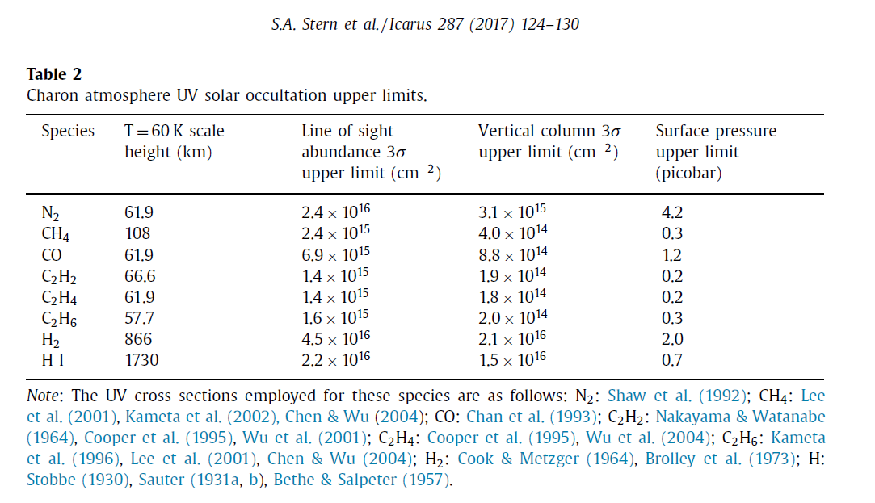
1. Surface pressure limit solar occultation
N₂: 3.15e-9 torr
CH₄: 2.25e-10 torr

Slide 29
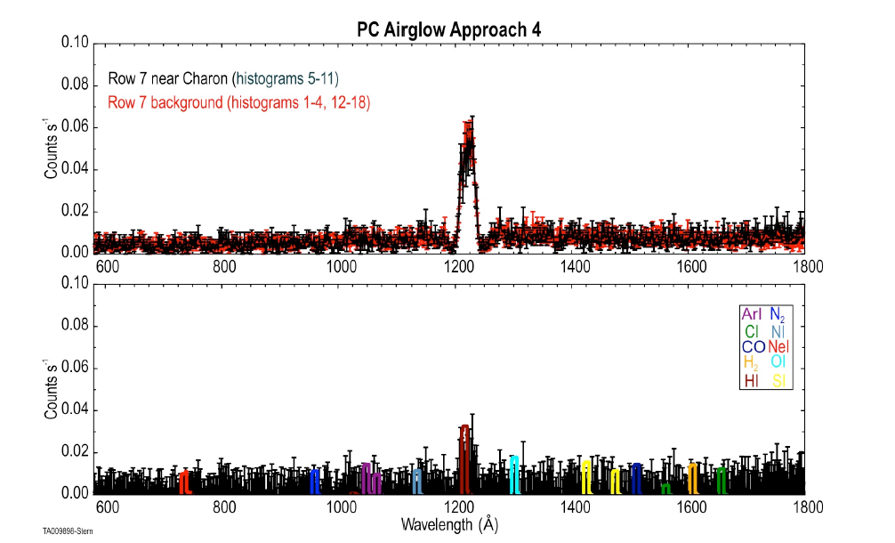
2. Airglow of gases

Slide 30
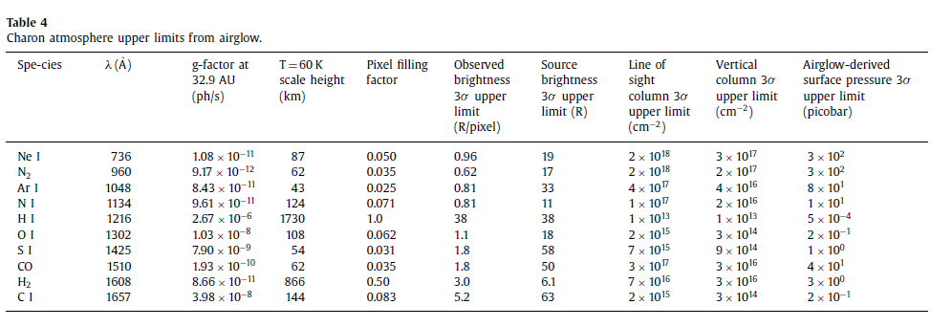
Upper limit: 0.3 nano bar = 2.25e-7 torr

